Slide 1
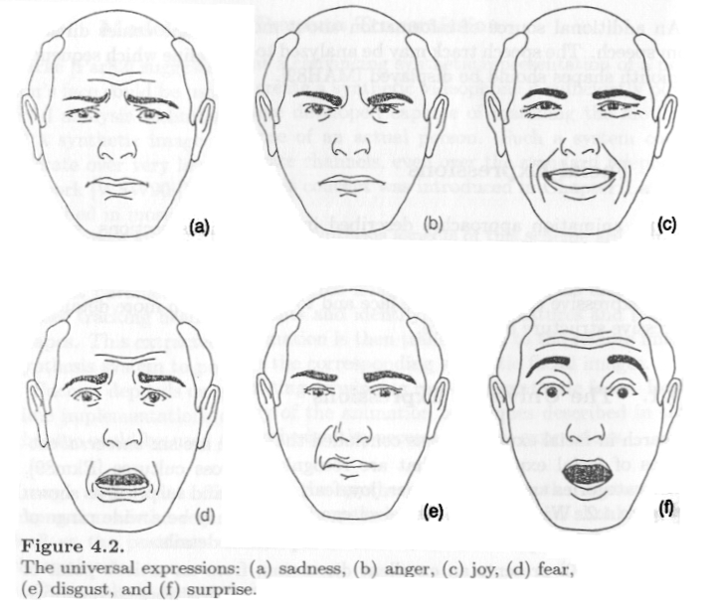
Chapter 4 Facial Animation

Slide 2
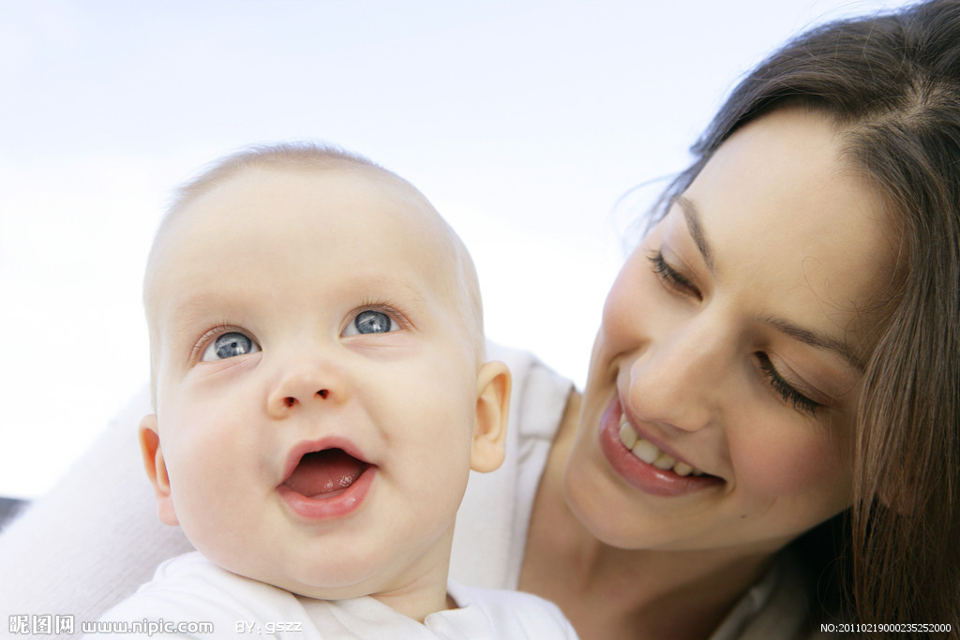
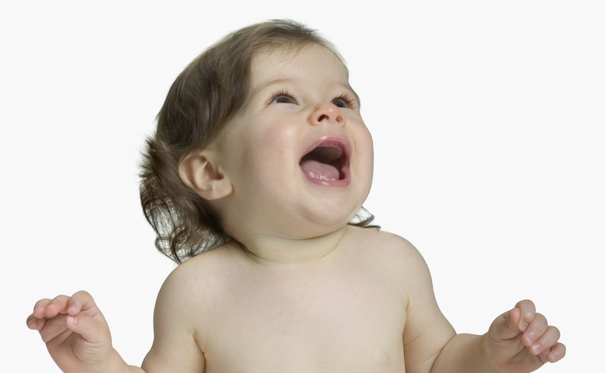
Content
Overview
Historical view: FACS
Shape Interpolation
Techniques
Traditional animation
Muscle-vector techniques
Mass-spring models
Mass-spring + muscles
Performance based animation
Summary

Slide 3
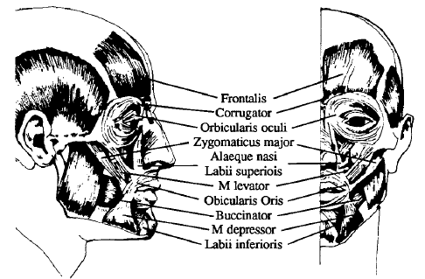
1.1 Anatomy of the face
There are 268 voluntary muscles that contribute to your expression
Three main types:
线性肌肉Linear muscles (share a common anchor)
块状肌肉Sheet muscles (run parallel, activated together)
收缩肌肉Sphincter muscles (contract to a center point)
Notes:
voluntary muscles: 随意肌
Sphincter muscles: 括约肌

Slide 4
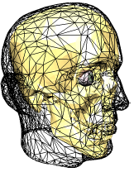
1.2 Muscles
Bundles of thousands of individual fibers
Thankfully, can be modeled as these bundles
When activated, all of the fibers contract
Contraction only
Most parts of the body use opposing pairs of muscles, but the face relies on the skin
Bulging（膨胀）
Occurs due to volume preservation
Thicker on contraction, thinner on elongation
Important for realistic faces (e.g. pouting（撅嘴）lips)
Notes:
Bulging: 膨涨、凸出
Elongation: 延长
Pouting: 撅嘴，生气
Contraction:收缩

Slide 5
1.3 Skin
Epidermis 表皮
Thin, stiff layer of dead skin
Dermis 真皮
Primary mechanical layer
Collagen（胶原蛋白） and Elastin fibers
Subcutaneous 皮下or Fatty tissue
Allows skin to slide over muscle bundles
Varies in thickness
Notes:
Epdiermis:表皮
Dermis：n. 真皮,皮肤 subcutaneous：adj. 皮下的 Elastin： 弹性蛋白
Collagen：胶原蛋白

Slide 6
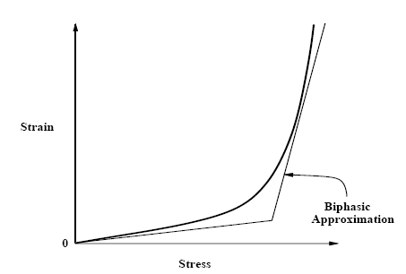
1.4 Modeling viscoelastic skin
Collagen胶原质 fibers - low strain for low extensions
Near maximum expansion, strain rises quickly
When allowed to, elastin弹性蛋白 fibers return system to rest state quickly
Biphasic model:
Two piecewise linear modes
Threshold extension to pick spring constant
Notes:
Viscoelastic: adj.[物]黏弹性的
collagen: n.胶原质
Elastin: n.[生化]弹性蛋白
Strain：拉紧
Biphasic:二阶段
Piecewise:分段的

Slide 7
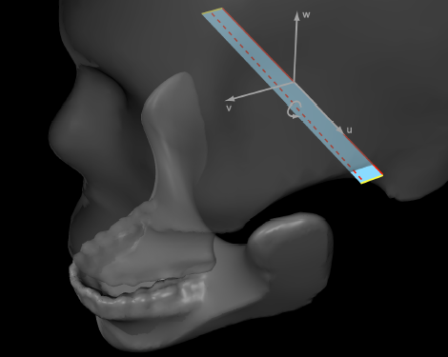
1.5 The skull
Unlike most of the body, the face only has a single joint
All other expression is due to computer-unfriendly soft tissues
Can be treated as a rigid body

Slide 8
Content
Overview
Historical view: FACS
Shape Interpolation
Techniques
Traditional animation
Muscle-vector techniques
Mass-spring models
Mass-spring + muscles
Performance based animation
Summary

Slide 9
Facial Action Coding System (FACS)
Proposed by Ekman and Friesan in 1978.
Describes facial movement in terms of the muscles involved
Purposely ignores invisible and non-movement changes (such as blushing)
Defines 46 action units pertaining to expression-related muscles
Additional 20 action units for gross head movement and eye gaze.
Notes:
Blush:脸红

Slide 10
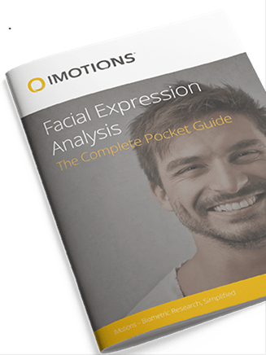
FACS
Describes a set of ‘Action Units’ (AUs) that correspond to basic actions (some map to individual muscles, but other involve multiple muscles, or even joint motion)
Expressions are built from basic action units
网址：
https://imotions.com/blog/facial-action-coding-system/
Notes:
dimple：n. 酒窝,笑窝。vt. & vi. 使起微凹,(使)现出酒窝

Slide 11
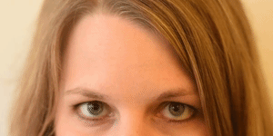
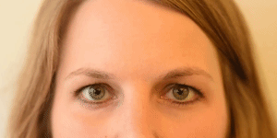

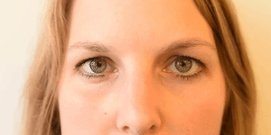
FACS
Examples:
Action Unit | Description | Facial Muscle
1 | Inner Brow Raiser | Frontalis, pars medialis
2 | Outer Brow Raiser | Frontalis, pars lateralis
51 | Head Turn Left
61 | Eyes Turn Left
Notes:
dimple：n. 酒窝,笑窝。vt. & vi. 使起微凹,(使)现出酒窝

Slide 12
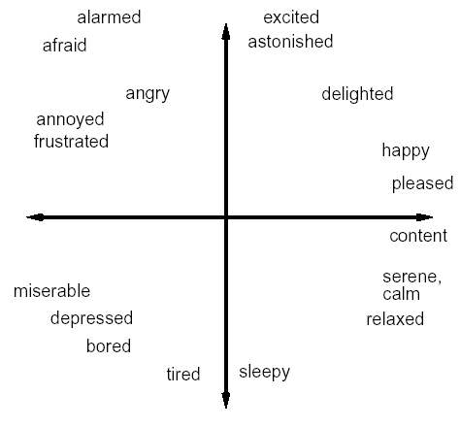
Emotional Axes
Emotional states can loosely be graphed on a 2-axis system
X=Happy/Sad
Y=Excited/Relaxed

Slide 13
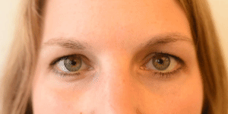
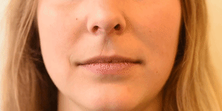
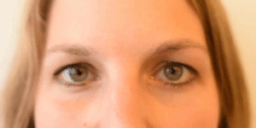
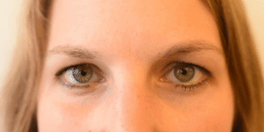
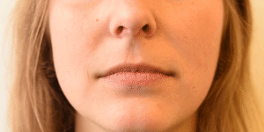
FACS
Emotion | Action Units | Description
Happiness / Joy | 6 + 12 | Cheek Raiser Lip Corner Puller
Emotion | Action Units | Description
Sadness | 1 + 4 + 15 | Inner Brow Raiser, Brow Lowerer, Lip Corner Depressor
Notes:
dimple：n. 酒窝,笑窝。vt. & vi. 使起微凹,(使)现出酒窝

Slide 14
Content
Overview
Historical view: FACS
Shape Interpolation
Techniques
Traditional animation
Muscle-vector techniques
Mass-spring models
Mass-spring + muscles
Performance based animation
Summary

Slide 15
3.1 Bone Based Methods
Using joints & skinning to do the jaw bone and eyeballs makes a lot of sense
One can also use a pretty standard skeleton system to do facial muscles and skin deformations, using the blend weights in the skinning
This gives quite a lot of control and is adequate for medium quality animation

Slide 16
3.2 Shape Interpolation Methods
One of the most popular methods in practice is to use shape interpolation
Several different key expressions are sculpted ahead of time
The key expressions can then be blended on the fly to generate a final expression
One can interpolate the entire face (happy to sad) or more localized zones (left eyelid, brow, nostril flare…)
Notes:
nostril flare:鼻孔耀斑

Slide 17
3.2 Shape Interpolation
Shape interpolation allows blending between several pre-sculpted expressions to generate a final expression
It is a very popular technique, as it ultimately can give total control over every vertex if necessary
However, it tends to require a lot of set up time
It goes by many names:
Morphing
Morph Targets
Multi-Target Blending
Vertex Blending
Geometry Interpolation
etc.

Slide 18
3.2.1 Interpolation Targets
One starts with a 3D model for the face in a neutral expression, known as the base
Then, several individual targets are created by moving vertices from the base model
The topology of the target meshes must be the same as the base model (i.e., same number of verts & triangles, and same connectivity)
Each target is controlled by a DOF Ф_{i} that will range from 0 to 1

Slide 19
3.2.2 Morph Target DOFs
We need DOFs to control the interpolation
They will generally range from 0 to 1
This is why it is nice to have a DOF class that can be used by joints, morph targets, or anything else we may want to animate
Higher level code does not need to distinguish between animating an elbow DOF and animating an eyebrow DOF

Slide 20
3.2.3 Shape Interpolation Algorithm
To compute a blended vertex position:
The blended position is the base position plus a contribution from each target whose DOF value is greater than 0 (targets with a DOF value of 0 are essentially 'off' and have no effect)
If multiple targets affect the same vertex, their results combine in a 'reasonable' way

Slide 21
3.2.4 Weighted Blending & Averaging
Weighted sum:
Additive blend:

Slide 22
3.2.5 Normal Interpolation
To compute the blended normal:
Note: if the normal is going to undergo further processing (i.e., skinning), we might be able to postpone the normalization step until later

Slide 23
Shape Interpolation Algorithm
To compute a blended vertex position:
The blended position is the base position plus a contribution from each target whose DOF value is greater than 0
To blend the normals, we use a similar equation:
We won't normalize them now, as that will happen later in the skinning phase

Slide 24
3.2.6 Shape Interpolation and Skinning
Usually, the shape interpolation is done in the skin's local space
In other words, it's done before the actual smooth skinning computations are done

Slide 25
3.2.7 Smooth Skin Algorithm
The deformed vertex position is a weighted average over all of the joints that the vertex is attached to.
Each attached joint transforms the vertex as if it were rigidly attached.
Then these values are blended using the weights:

Slide 26
3.2.7 Smooth Skin Algorithm
Where:
v’’ is the final vertex position in world space
w_{i} is the weight of joint i
v’ is the untransformed vertex position (output from the shape interpolation)
B_{i} is the binding matrix (world matrix of joint i when the skin was initially attached)
W_{i} is the current world matrix of joint i after running the skeleton forward kinematics

Slide 27
3.2.7 Smooth Skin Algorithm
Note:
B remains constant, so B⁻¹ can be computed at load time
B⁻¹·W can be computed for each joint before skinning starts
All of the weights must add up to 1:

Slide 28
3.2.7 Smooth Skinning Normals
Blending normals is essentially the same, except we transform them as directions (x, y, z, 0) and then renormalize the results

Slide 29
Equation Summary
Skeleton
Morphing
Skinning

Slide 30
3.2.8 Target Storage
Morph targets can take up a lot of memory. This is a big issue for video games, but less of a problem in movies.
The base model is typically stored in whatever fashion a 3D model would be stored internally (verts, normals, triangles, texture maps, texture coordinates…)
The targets, however, don't need all of that information, as much of it will remain constant (triangles, texture maps…)
Also, most target expressions will only modify a small percentage of the verts

Slide 31
3.2.8 Target Storage
Therefore, the targets really only need to store the positions and normals of the vertices that have moved away from the base position (and the indices of those verts)
Also, we don't need to store the full position and normal, only the difference from the base position and base normal. i.e., other than storing v₃, we store v₃-v_{base}
There are two main advantages of doing this:
Fewer vector subtractions at runtime (saves time)
As the deltas will typically be small, we should be able to get better compression (saves space)

Slide 32
3.2.8 Target Storage
In a pre-processing step, the targets are created by comparing a modified model to the base model and writing out the 'difference'
The information can be contained in something like this:
class MorphTarget {
int NumVerts;
int Index [ ];
Vector3 DeltaPosition [ ];
Vector3 DeltaNormal [ ];
}

Slide 33
3.2.9 Vascular(血管) Expression
Vascular expression is a fancy term to describe blushing and other phenomena relating to the color change in the face
Adding subtle changes in facial color that relate to skin distortion can help improve realism
This can be achieved either by blending a color values with every vertex (along with the position and normal)
Alternately, one could use a blush texture map controlled by a blended intensity value at each vertex
Notes:
Vascular: 血管
Blush:脸红

Slide 34
3.2.10 Wrinkles
One application of auxiliary data interpolation is adding wrinkles
Every vertex stores an auxiliary property indicating how wrinkled that area is
On the base model, this property would probably be 0 in most of the verts, indicating an unwrinkled state
Target expressions can have this property set at or near 1 in wrinkled areas

Slide 35
3.2.10 Wrinkles
When facial expressions are blended, this property is blended per vertex just like the positions and normals (but should be clamped between 0 and 1 when done)
For rendering, this value is used as a scale factor on a wrinkle texture map that is blended with the main face texture
Even better, one could use a wrinkle bump map or displacement map
Notes:
clamped 固支

Slide 36
3.2.11 Colors and Other Properties
In addition to interpolating the positions and normals, one can interpolate other per-vertex data:
Colors
Alpha
Texture coordinates
Auxiliary shader properties

Slide 37
Content
Overview
Historical view: FACS
Shape Interpolation
Techniques
Traditional animation
Muscle-vector techniques
Mass-spring models
Mass-spring + muscles
Performance based animation
Summary

Slide 38
4.1 Traditional techniques
Key-framing
Extremely fast
Extremely hard to model appropriately
Large storage footprint
Basically never used to edit faces, but works as a final format, especially for games
MPEG-4 approach
Defines 84 feature points with position and zone of influence on a few basis key frames of a standard 3D mesh
Defines animation independently of the visual rep.
Notes:
Footprint：占用的空间
Rep: 棱纹平布

Slide 39
MPEG-4 Facial Animation
68 facial action parameters (FAPs), defined in terms of face independent FAP units (FAPUs)
Most define a rotation or translation of one or more feature points, with a few selecting entirely new key frames (e.g. an emotion basis)
Same animation can be used on different model, provided the model is properly annotated
Some MPEG-4 feature points

Slide 40
Content
Overview
Historical view: FACS
Shape Interpolation
Techniques
Traditional animation
Muscle-vector techniques
Mass-spring models
Mass-spring + muscles
Performance based animation
Summary

Slide 41
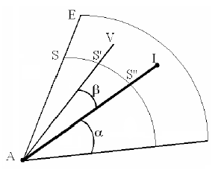
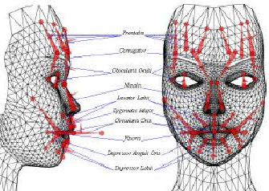
4.2.1 Muscle vectors
Muscle vector properties
Attachment point (to bone)
Insertion point (to skin)
Influences nearby skin vertices, more strongly along the direction vector and close to the muscle.

Slide 42
4.2.1 Muscle vectors (2)
Advantages
Fast
Compact, easily controlled
Disadvantages
Treats the skin like a 2D surface, no concept of curvature
Artifacts when vertices are within two influences
Notes:
Compact:简洁

Slide 43
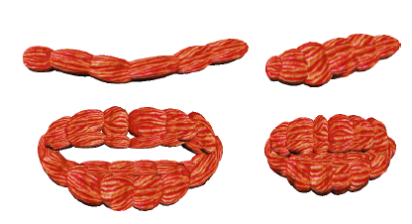
4.2.2 Muscle Based Animation
Model the muscles as ellipsoids
Long or curved muscles are broken into piecewise linear segments
Scale the diameter as length changes to implement bulging in a nearly volume-preserving manner.
Notes:
Bulging:膨胀

Slide 44
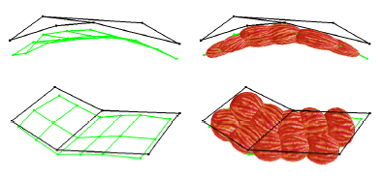
4.2.2 Muscle Based Animation
an easy-to-use editor to define muscles
Provided a skin model, automatically creates skull
Users sketch sheets of muscles and they are iteratively subdivided into individual muscle chains of ellipsoids
Automatic fitting process to place the ellipsoids underneath the skin.

Slide 45
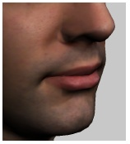
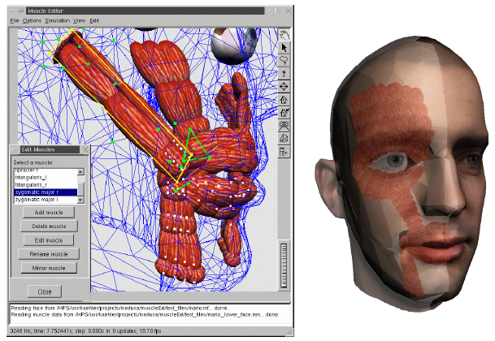
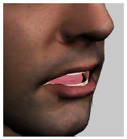
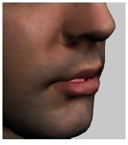
4.2.2 Muscle Based Animation

Slide 46
Content
Overview
Historical view: FACS
Shape Interpolation
Techniques
Traditional animation
Muscle-vector techniques
Mass-spring models
Mass-spring + muscles
Performance based animation
Summary

Slide 47
Physics-based model
4.3 Mass-spring models
Idea:
Represent and manipulate expressions based on physical characteristics of skin tissue and muscles
Real anatomy is too complex!
to date, no facial animation system represents and simulates the complete, detailed anatomy of the human head
Reduce complexity to obtain animateable model
Need to build appropriate models for muscles and skin tissue

Slide 48
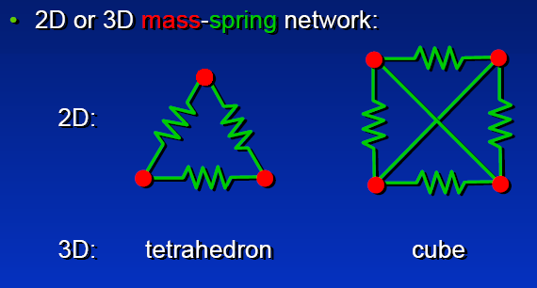
4.3 Mass-spring models
2D or 3D mass-spring network:
2D
3D tetrahedron cube
Notes:
Tetrahedron:四面体

Slide 49
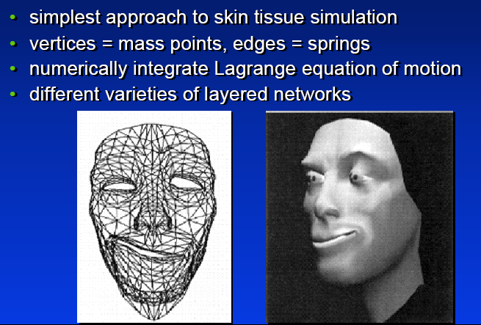
4.3.1 Mass-spring models (Two Layers)
Simplest approach to skin tissue simulation
vertices = mass points, edges = springs
Numerically integrate Lagrange equation of motion
Different varieties of layered networks

Slide 50
4.3.1 Mass-spring models (Two Layers)
Model the skin (and sometimes muscle and bones) as a number of point masses connected by springs, like a cloth

Slide 51
4.3.2 Mass-spring models (Three Layers)
The entire face as a three-layer mass-spring system
Horizontal layers and interconnects:
Epidermis
Fatty tissue
Underlying bone.
Vertical interconnects:
Top-to-middle springs correspond to the dermis
Middle-to-bottom springs provide the simulation of muscle fibers.
Notes:
Epidermis:表皮
Dermis:真皮

Slide 52
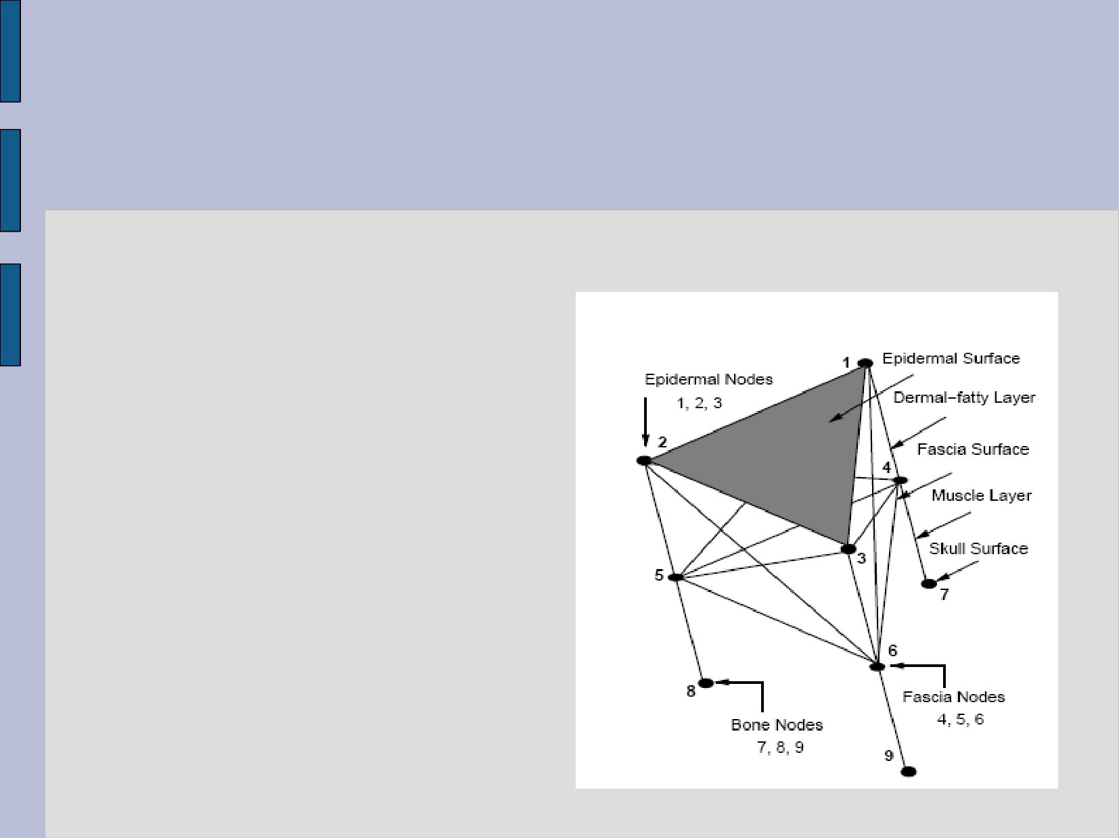
(1) The Anatomical Model
The face can be modeled by two layers and three surfaces
Dermal-fatty Layer
Muscle Layer
Epidermal surface
Fascia筋膜Surface
Skull Surface
Notes:
Dermal: adj.皮肤的, 真皮的
Epidermal: adj.[解][生]表皮的,外皮的
Fascia:筋膜

Slide 53
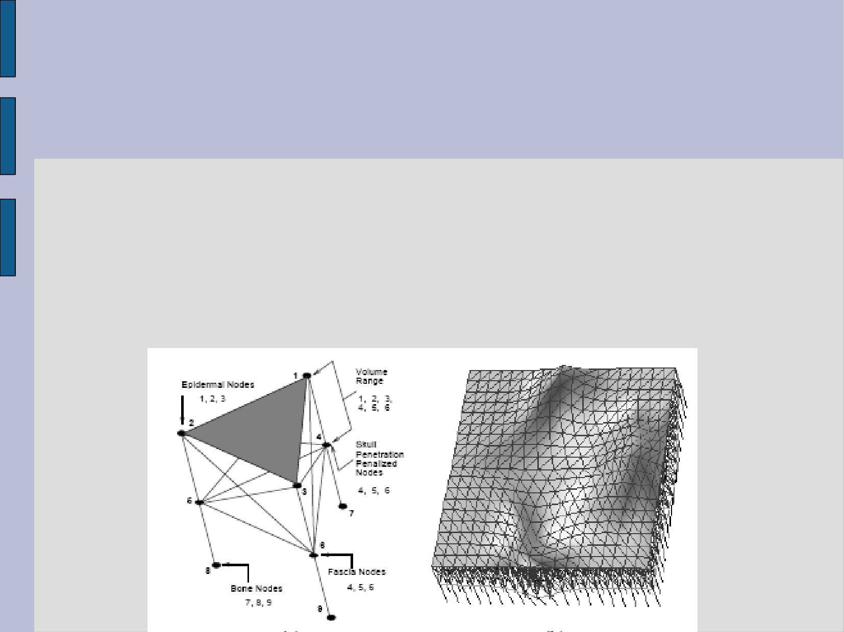
(2) The Volume Preservation Forces
The human skin is incompressible
Volume preservation force is needed to simulate the wrinkles
Pressing the node upwards proportionally to the decrement of the volume

Slide 54
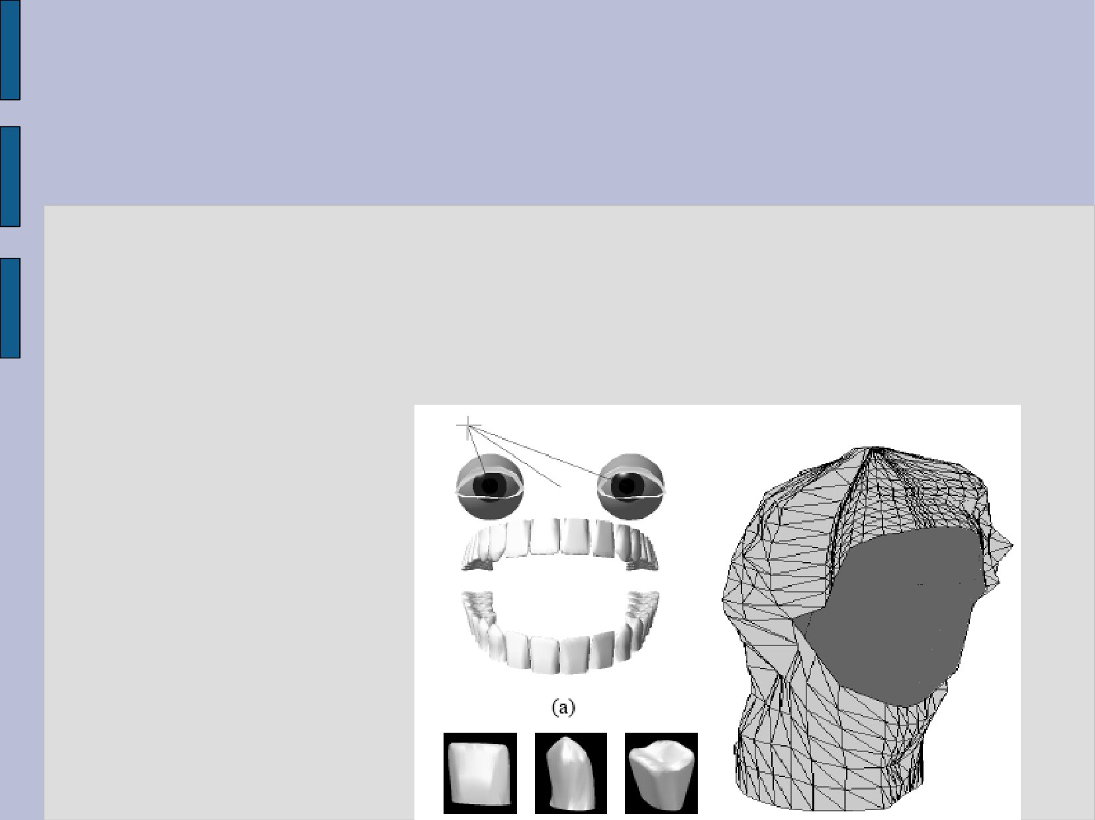
(3) Geometry models for other head components
Teeth, eyes, and neck are modeled separately
These data are difficult to be captured by the scanner

Slide 55
Content
Overview
Historical view: FACS
Shape Interpolation
Techniques
Traditional animation
Muscle-vector techniques
Mass-spring models
Mass-spring + muscles
Performance based animation
Summary

Slide 56
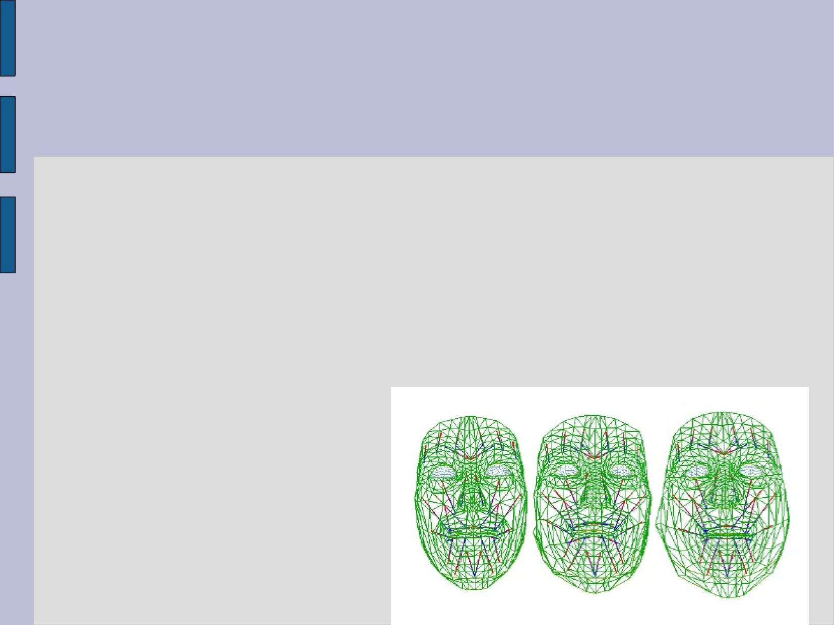
4.4 Mass-spring + muscles
Uses a mass-and-spring model to simulate facial muscles.
●
Muscles are of two types: linear muscles that pull and elliptic muscles that squeeze.
Muscle parameters: muscle vector and zone of muscle effect.

Slide 57
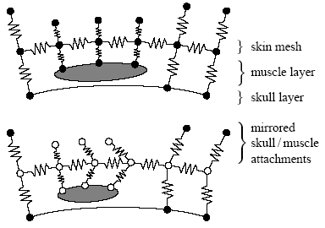
4.4 Mass-spring + muscles
To prevent interpenetrations, Kähler use preservation springs.
Each skin-muscle and skin-bone attachment point gets a mirrored phantom preservation spring acting on it.
Similar to penalty based approaches

Slide 58
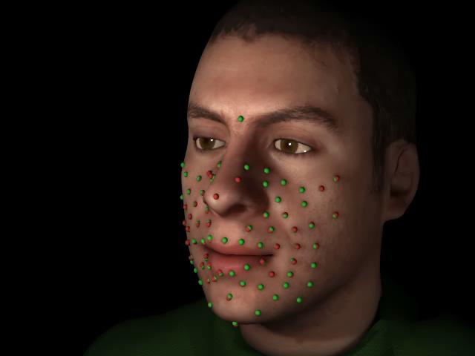
Demo

Slide 59
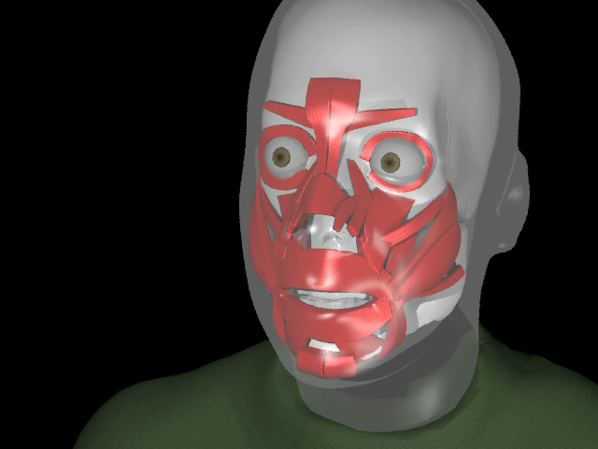
Demo

Slide 60
Content
Overview
Historical view: FACS
Shape Interpolation
Techniques
Traditional animation
Muscle-vector techniques
Mass-spring models
Mass-spring + muscles
Performance based animation
Summary

Slide 61
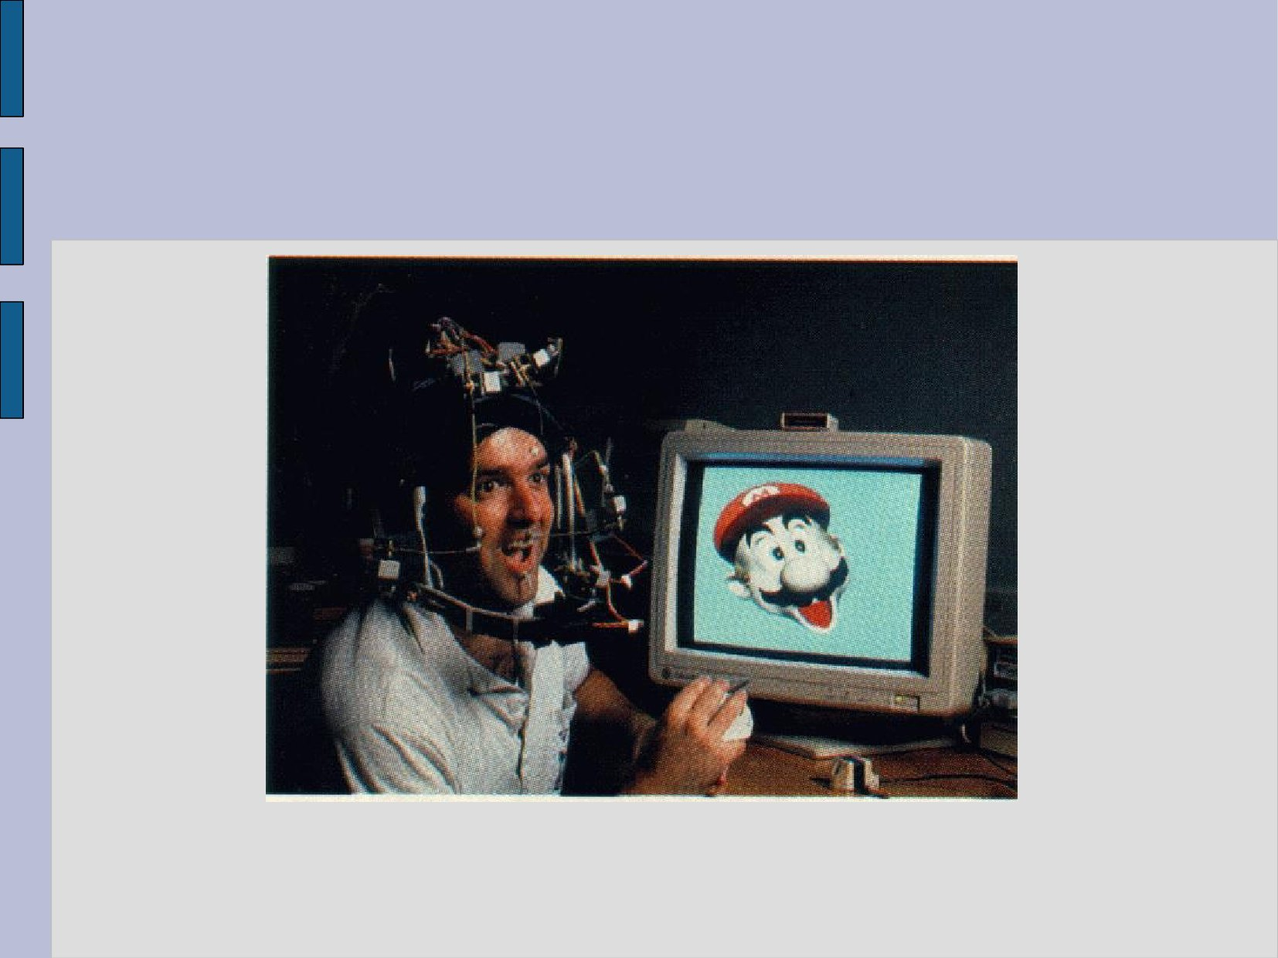
4.5 Performance Based Animation
Manually creating the keyframes by mouse is too tedious
The animators can use interactive input devices data gloves, or 3D trackers to edit the face
Expression mapping: various expressions are digitized directly from a real person

Slide 62
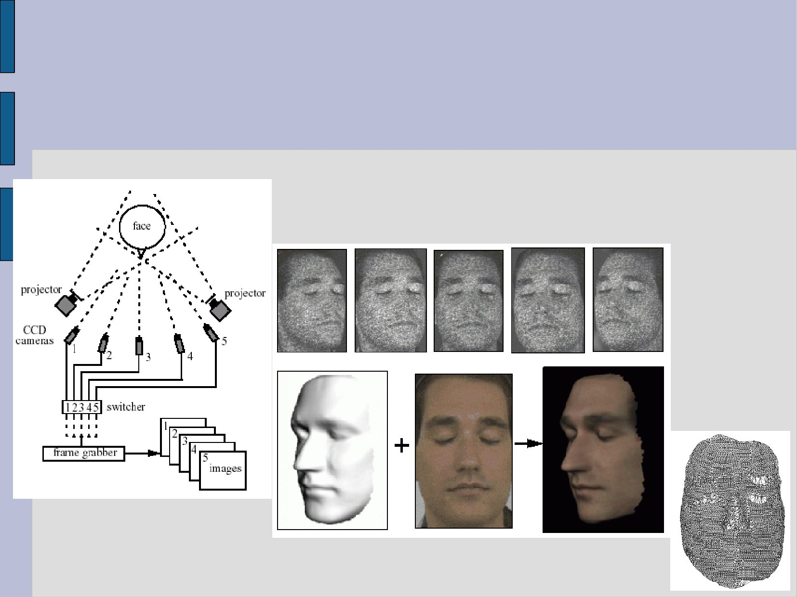
4.5.1 Photometric capturing
we can capture the facial movements in real-time
Using multiple photometric cameras
Capturing the surface shape as well as the textures
Setup of cameras and projectors
Photographs from different views
Mesh
Notes:
Photometric:光度计的，光度测定的;

Slide 63
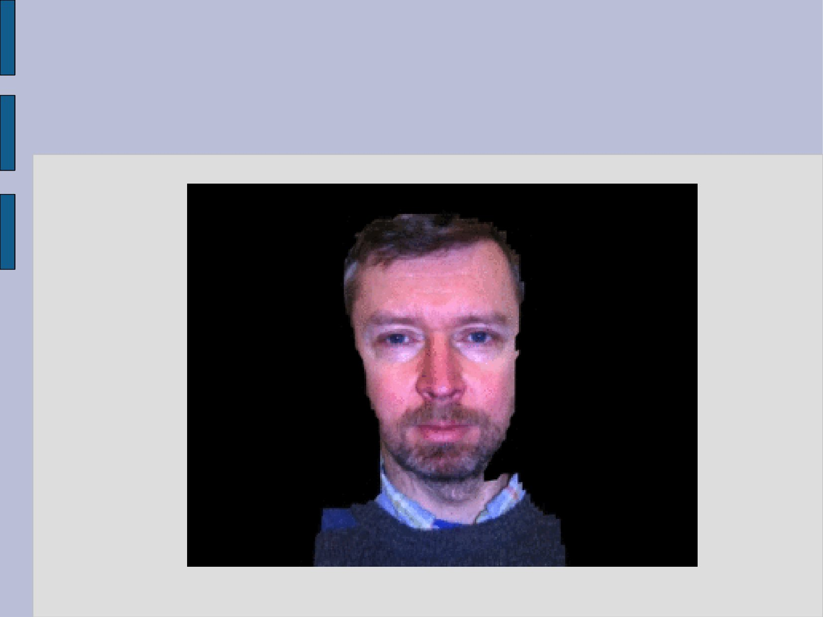
Like this…

Slide 64
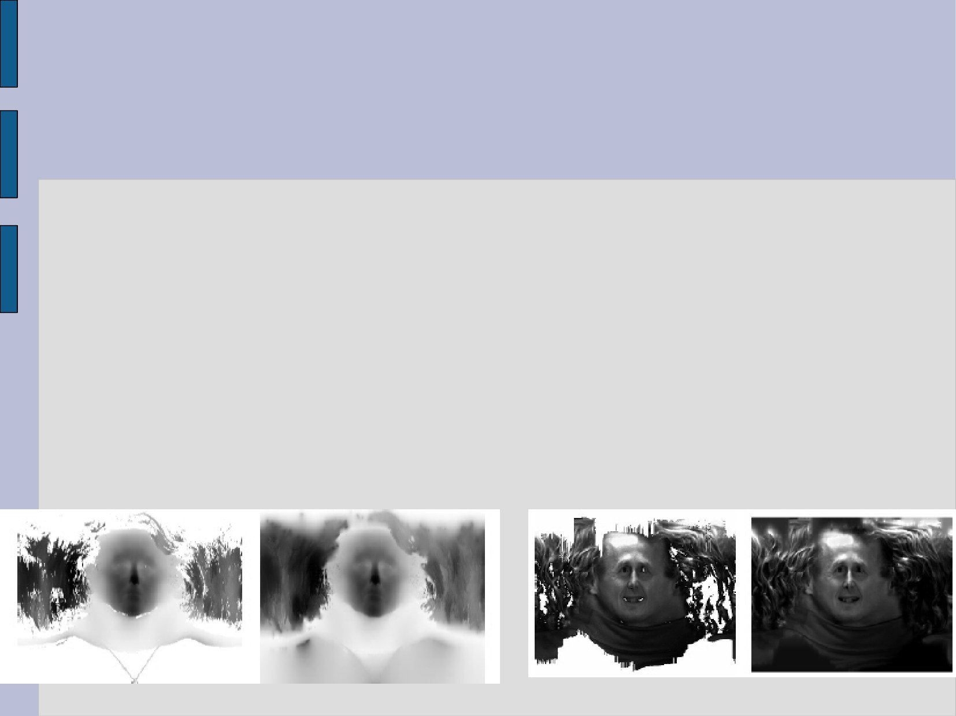
4.5.2 Cyberware Color Digitizer
A laser range scanner
Rotates 360 degrees around the subject
Laser stripes are projected on to the head
The range data is obtained
The color texture data is obtained at the same time

Slide 65
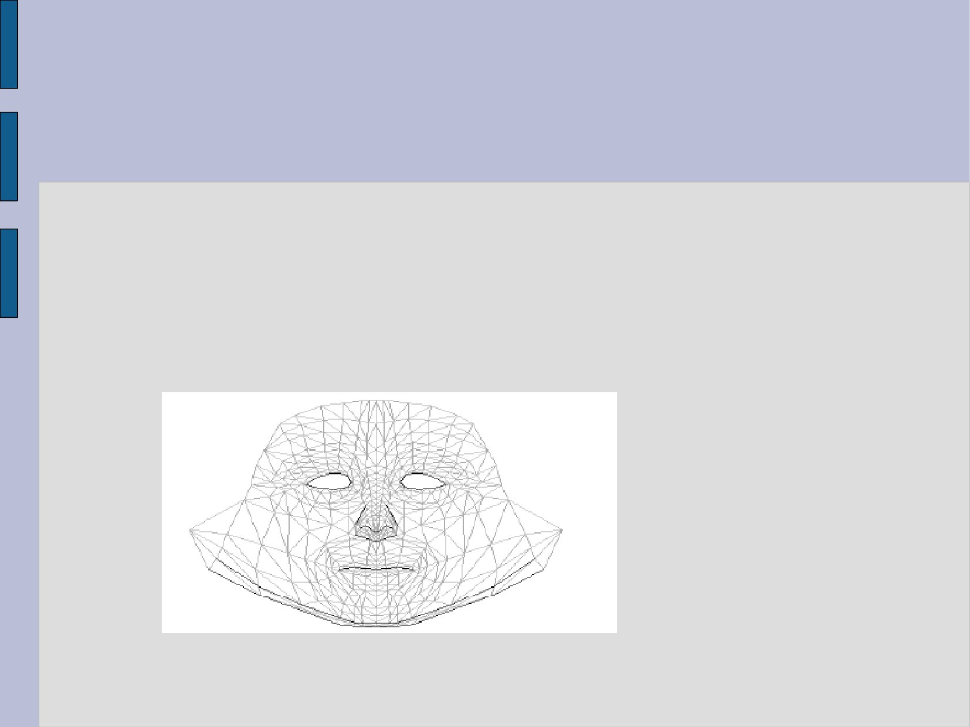
4.5.3 Procedure
(1) A Generic Face Mesh
Reduce the large array of range data to a geometric surface model
A generic face mesh is fit into the range data

Slide 66
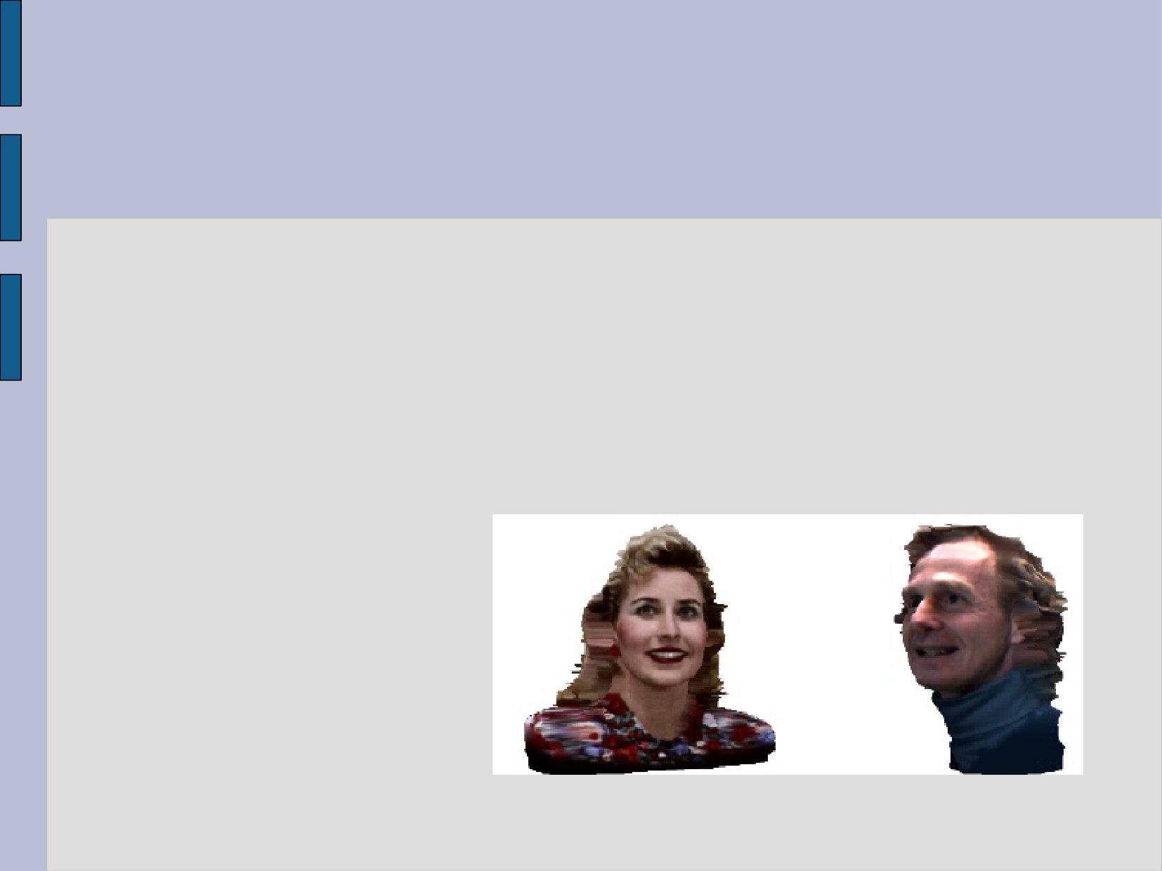
(2) Realistic models
If we want to simulate the expressions of real humans, we need to scan the surface of faces
We need the
Geometry data
Texture
of the face

Slide 67
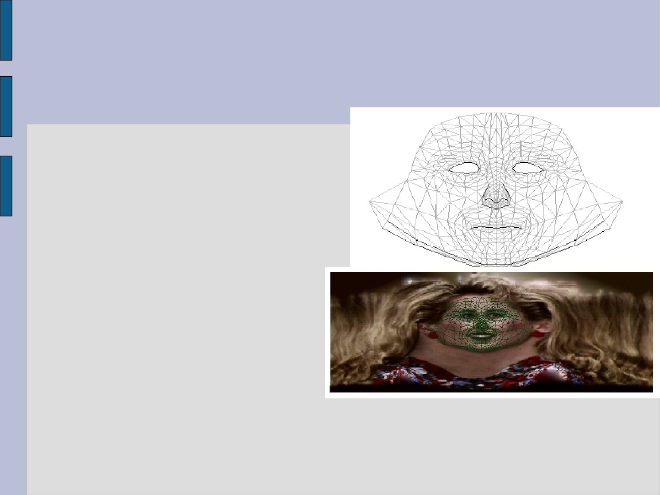
(3) Adaptation Procedure
1. Locate nose tip
2. Locate chin tip
3. Locate mouth contour
4. Locate chin contour
5. Locate ears
6. Locate eyes
7. Activate spring forces
8. Adapt hair mesh
9. Adapt body mesh
10. Store texture coordinates
Notes:
contour n. 外形,轮廓

Slide 68
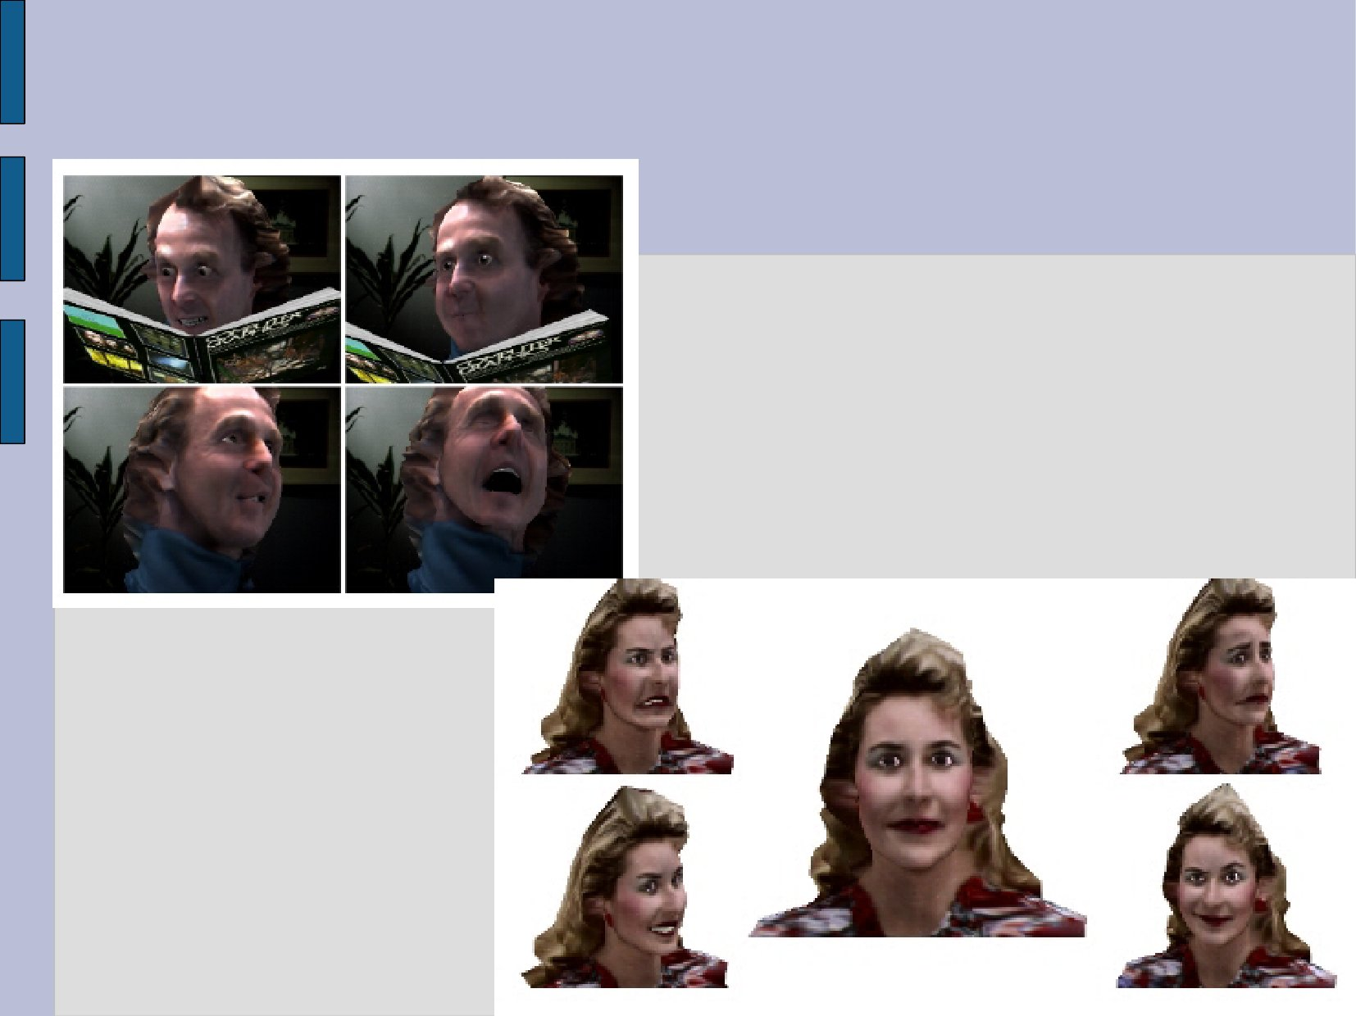
(4) From Lee and Terzopoulos

Slide 69
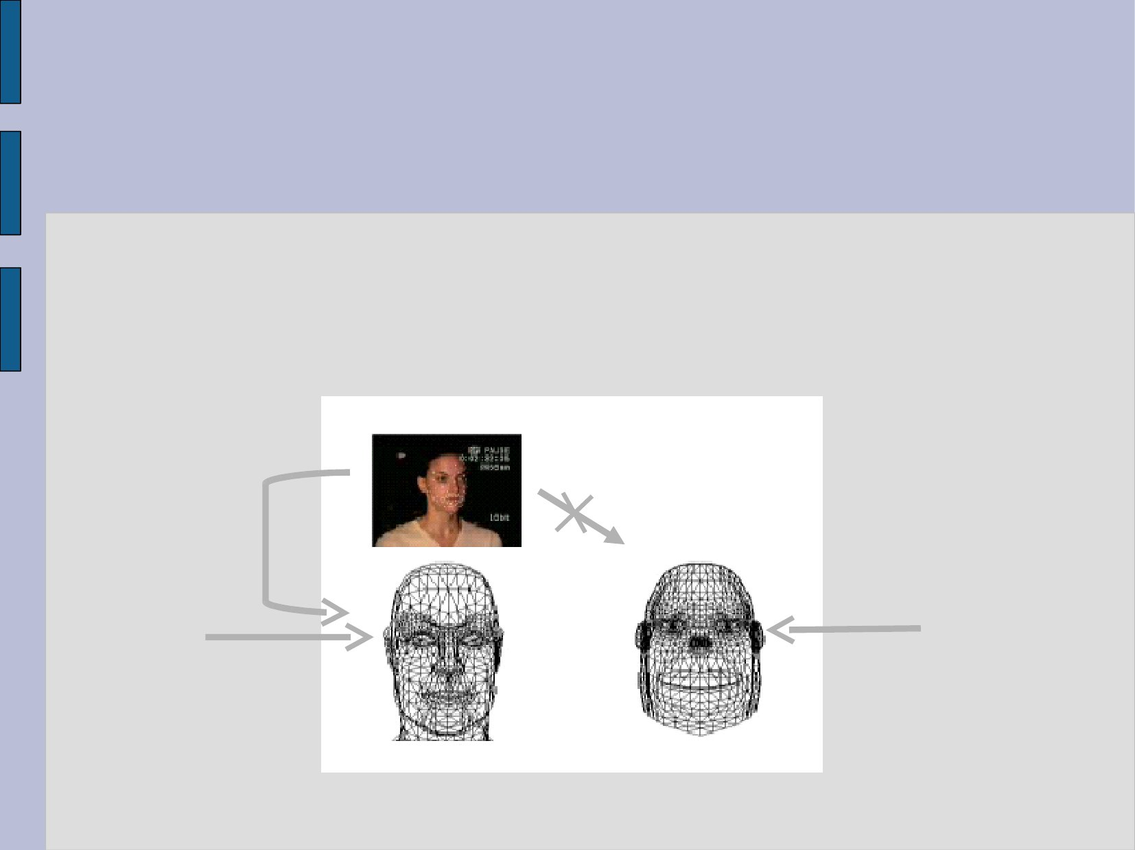
4.5.4 Expression Cloning
So we can capture the movements of the face
Let’s use such data to control the faces of other characters
Animation
Target
model
Source
model

Slide 70
(1) Problem
We cannot directly use the movements of the face, as the face shape can be different
Animation
Target
model
Source
model

Slide 71
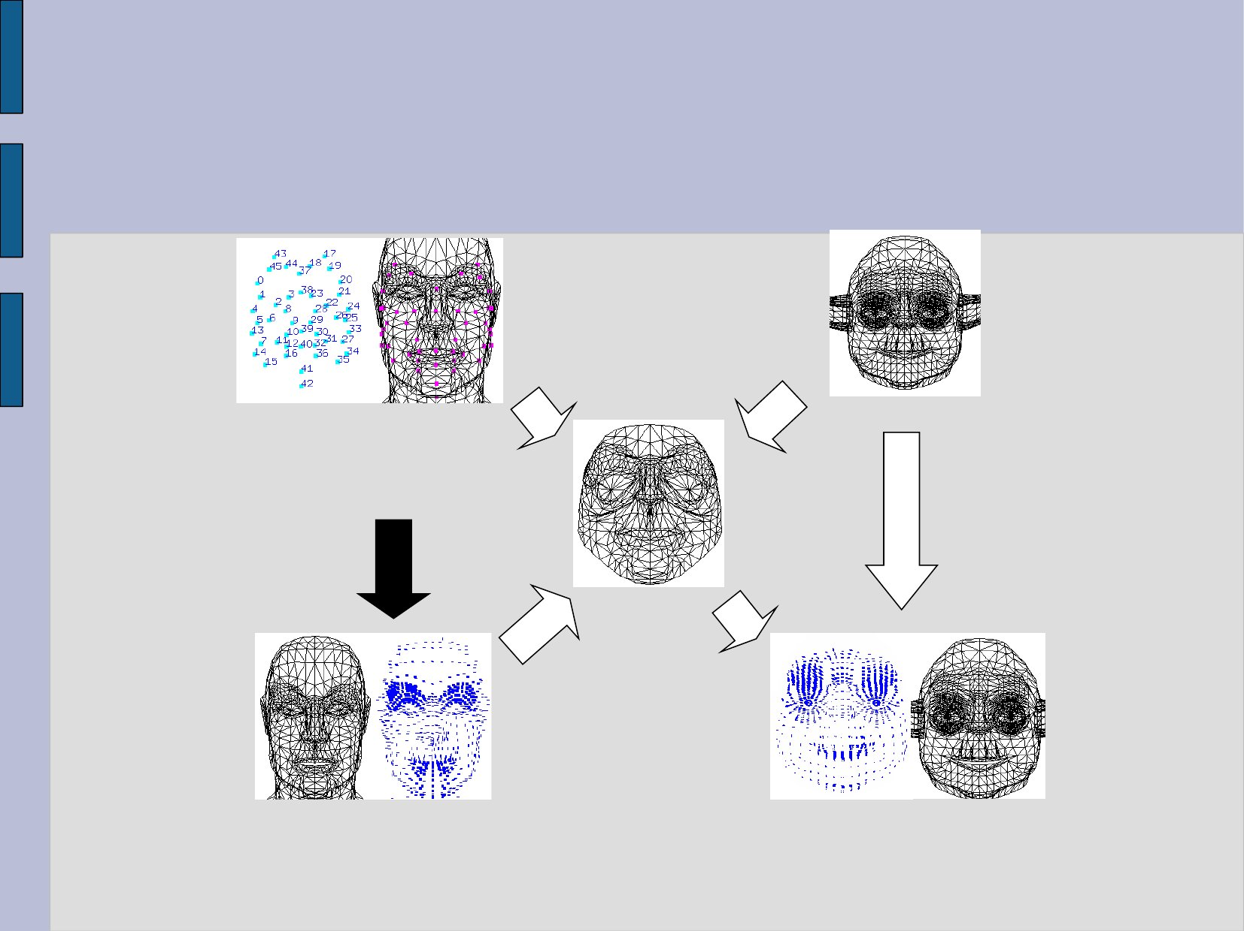
(2) Expression Cloning Outline
Source model
Target model
Dense surface Deform correspondences
Motion capture data or any animation mechanism
Cloned expressions
Vertex
displacements
Motion transfer
Source animation
Target animation

Slide 72
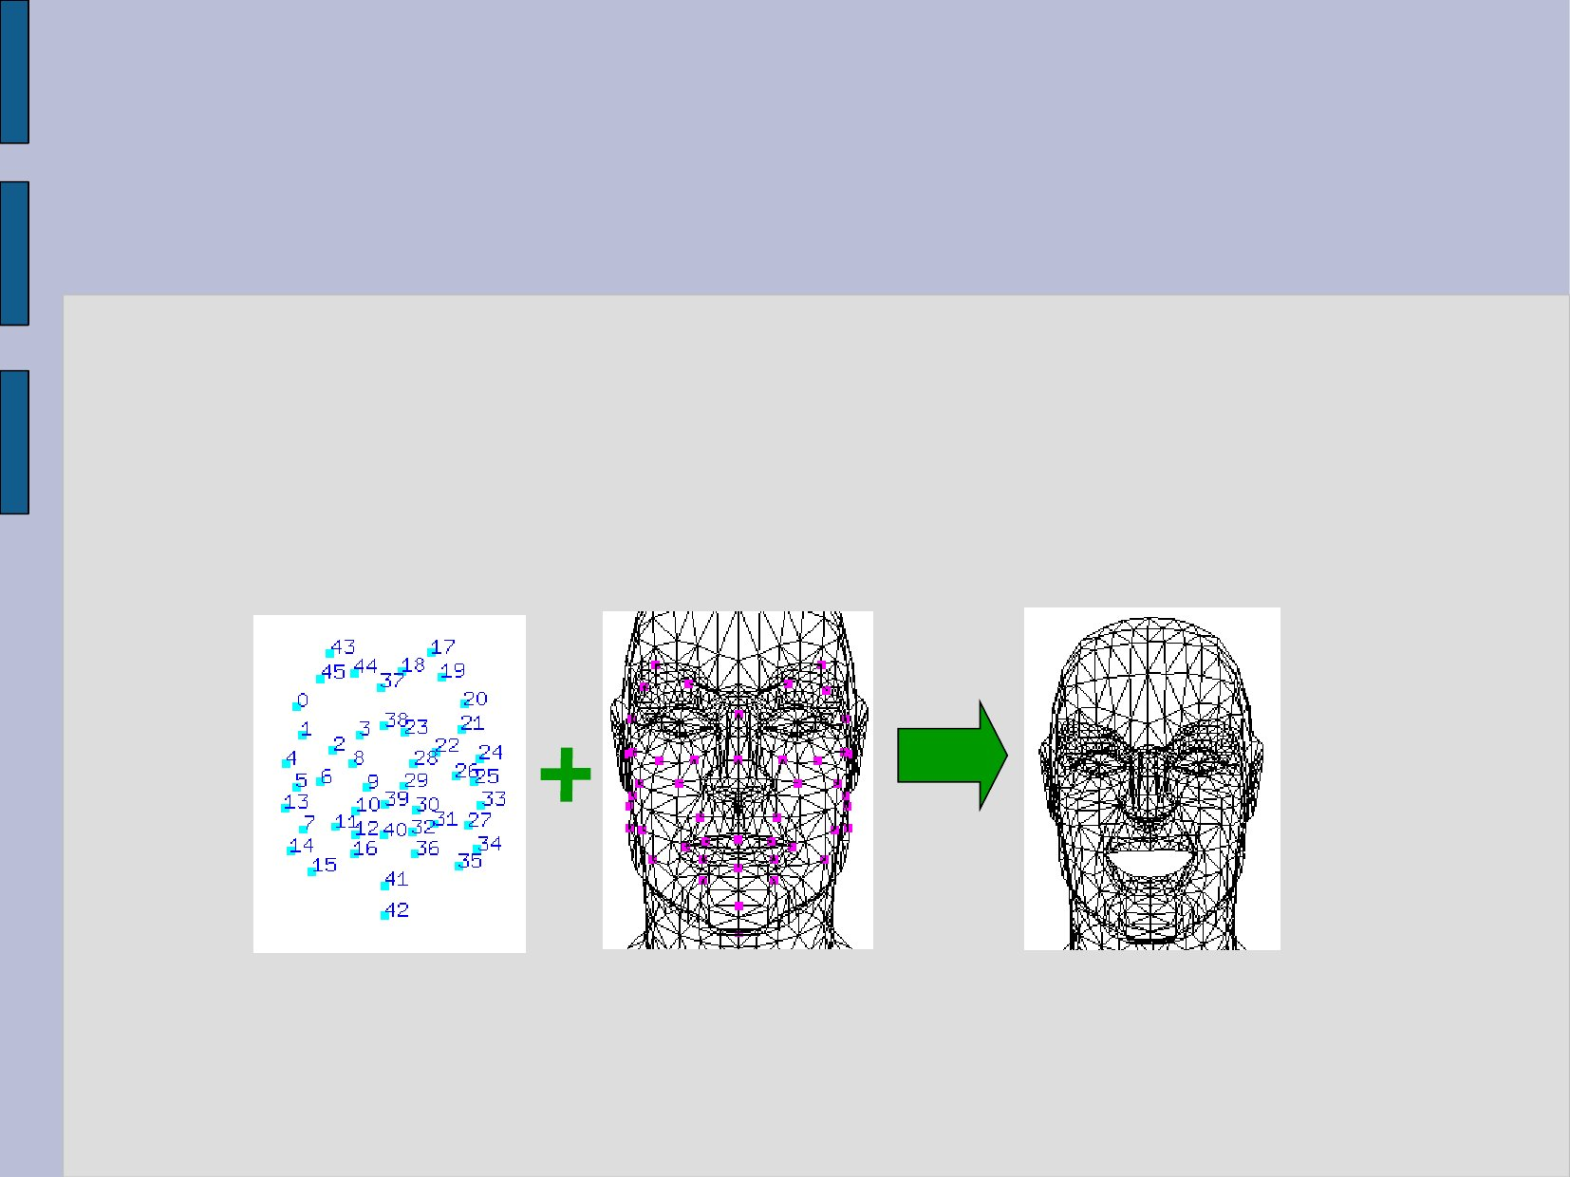
(3) Source Animation Creation
Use any existing facial animation method
Motion capture data
can also be hand made expressions
Motion capture data
Source model
Source animation

Slide 73
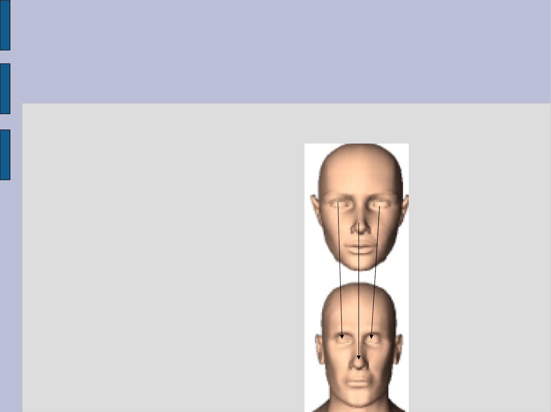
(4) Mapping the original face mesh to the target face
Specify some corresponding points on the target face, such as
Nose tip
Eye sockets
Lip contact line
Chin, etc

Slide 74
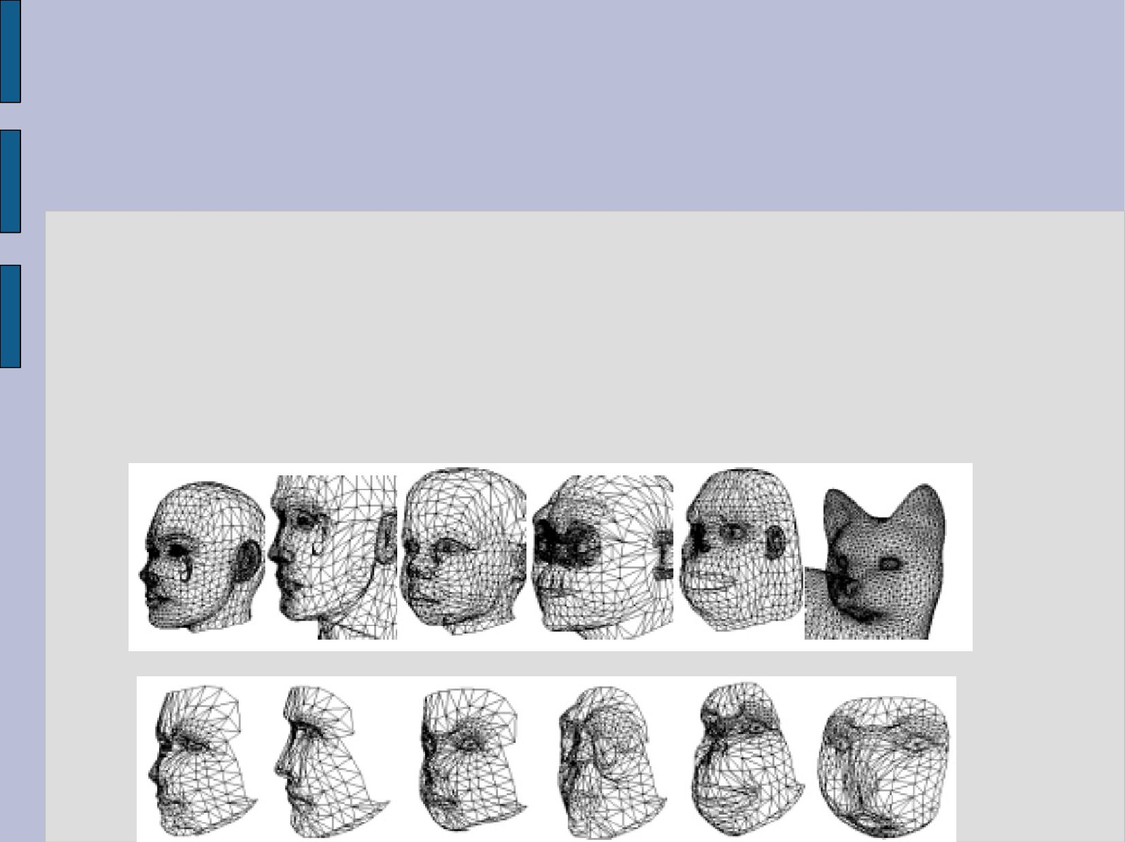
(5) Automatic dense correspondence
The source model is deformed to the target model
The corresponding points are used to find the dense correspondence
Finally, the source model is fitted to the target model by cylindrical projection

Slide 75
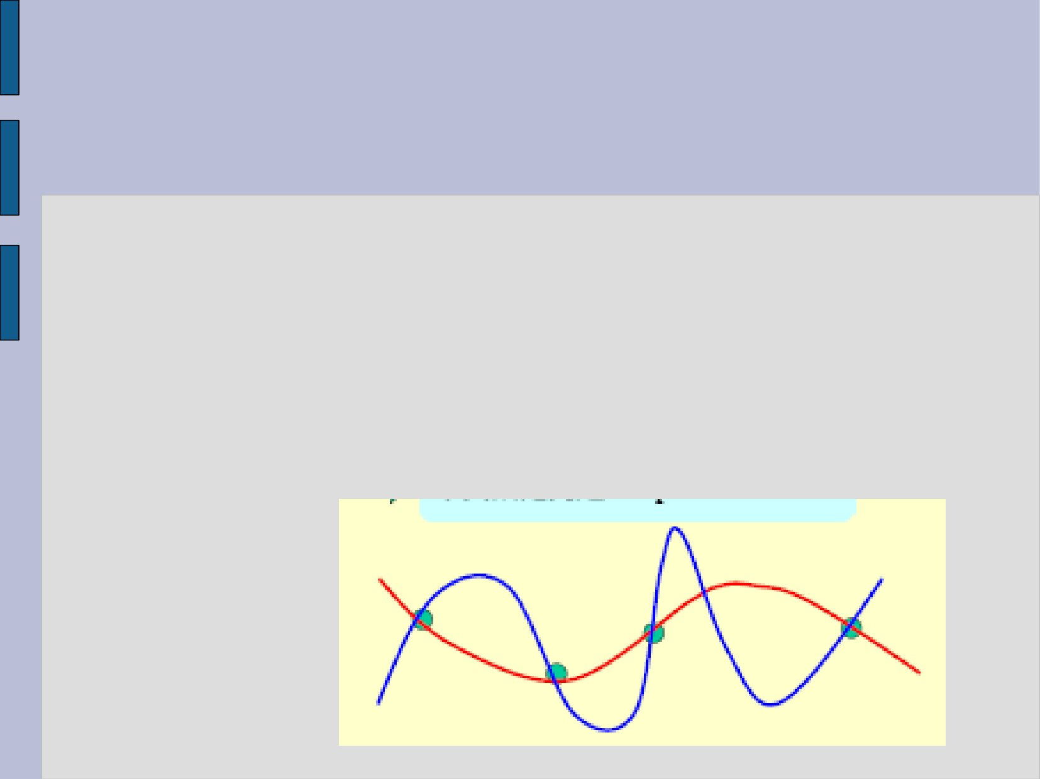
(6) Radial Basis Functions
Radial Basis Functions (RBF) are often used to create a mapping for a given data
Input x_i Output y_i (i = 0, 1, …, n-1)
Want a continuous mapping that satisfies
F(x_i) = y_i
While minimizing the oscillation
Notes:
Radial Basis Functions (RBF)：径向核函数

Slide 76
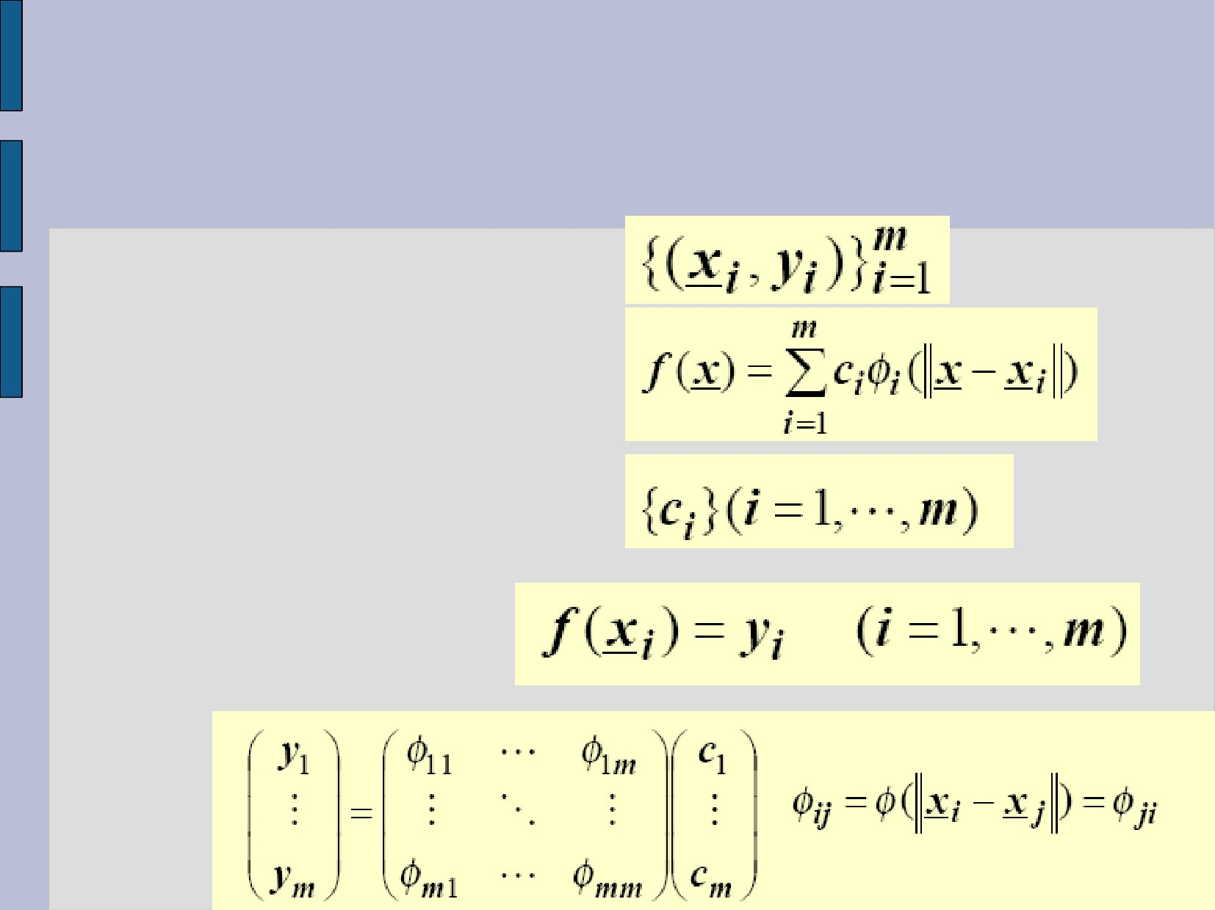
(6) Radial Basis Functions
Input, output
Represent F by sum of radial bases
Unknowns
constraints

Slide 77
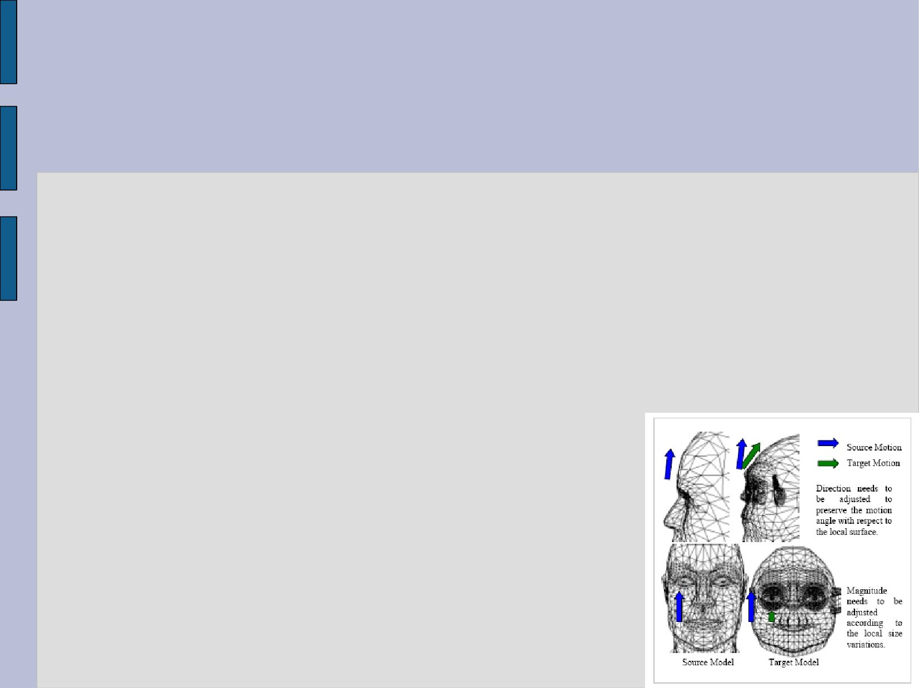
(7) Amending the motion vectors
The size and shape of the surface points are different between the source and target model
We need to adjust the direction and magnitude of the motion vectors
Rotation : adjusted by the difference of the normal vectors of the source and target
Magnitude : Scaled by the local size variation

Slide 78

(8) Results

Slide 79

Summary
Manual editing
Mass-spring + muscles
Capturing human motion
Expression Cloning
●
Notes:
旧金山大学的科研人员在美国《个性与社会心理学杂志》（Journal of Personality and Social Psychology）上报告说，他们的研究显示，先天失明者和视力正常的人在应对某一特定感情刺激时，会表现出相同的面部表情。由于先天失明者不可能通过观察学会面部表情表达，研究人员推断，表达情感的一些面部表情很可能是人类祖先进化的产物，由基因决定，属于天生。

Slide 80
Paper References
K. Waters. A muscle model for animating three-dimensional facial expression. Computer Graphics, 22(4):17–24, 1987.
Yuencheng Lee, Demetri Terzopoulos, and Keith Waters, Realistic Modeling for Facial Animation SIGGRAPH ’95
Expression Cloning Jun-Yong Noh, Ulrich Neumann, SIGGRAPH 2001, Computer Graphics Proceedings
Ekman P and Friesen W "Manual for the the Facial Action Coding System" Consulting Psychologist 1977 Press Palo Alto California
MPEG-4 standard

Slide 81
Paper References
E. Sifakis, I. Neverov, R. Fedkiw, Automatic Determination of Facial Muscle Activations from Sparse Motion Capture Marker Data, 2005
D. Terzopoulos, Waters, K., Physically-Based Facial Modeling, Analysis, and Animation, The Journal of Visualization and Computer Animation, 1990
K. Kahler, J. Haber, H.-P. Seidel, Geometry-based muscle modeling for facial animation, Proceedings Graphics Interface 2001
[Cohen93] M. M. Cohen, D.W. Massaro. Modeling coarticulation in synthetic visual speech, Computer Animation '93. Springer-Verlag, 1993.

